Slide 1
Data Mining - W9
Digital Trace Data

Slide 2
Announcement
Mid-term exam graded
Extension until Tomorrow (Midnight)
Final Presentations:
Screencast
Zoom presentation
Report Missing Students!!!!

Slide 3
Content
What is digital trace data
Strengths and weaknesses of digital trace data
Building apps and bots for social science research
Application programming interface (APIs)
Lab

Slide 4
What is Digital Trace Data?
Just as the invention of the telescope revolutionized the study of the heavens, so too by rendering the unmeasurable measurable, the technological revolution in mobile, Web, and Internet communications has the potential to revolutionize our understanding of ourselves and how we interact ... [T]hree hundred years after Alexander Pope argued that the proper study of humankind should lie not in the heavens but in ourselves, we have finally found our telescope. Let the revolution begin.
Duncan Watts (2011) in Everything Is Obvious: Once You Know the Answer

Slide 5
What is Digital Trace Data?
Social Media Sites: Facebook, Twitter
Web Search Data: Google, Bing
Blogs/Other Internet Forums: Reddit, Fandom
Administrative Data on Websites: Open NYC
Internet Archive - Digitization of Historical Texts/ Archive- audio-visual Data (Podcasts)

Slide 6
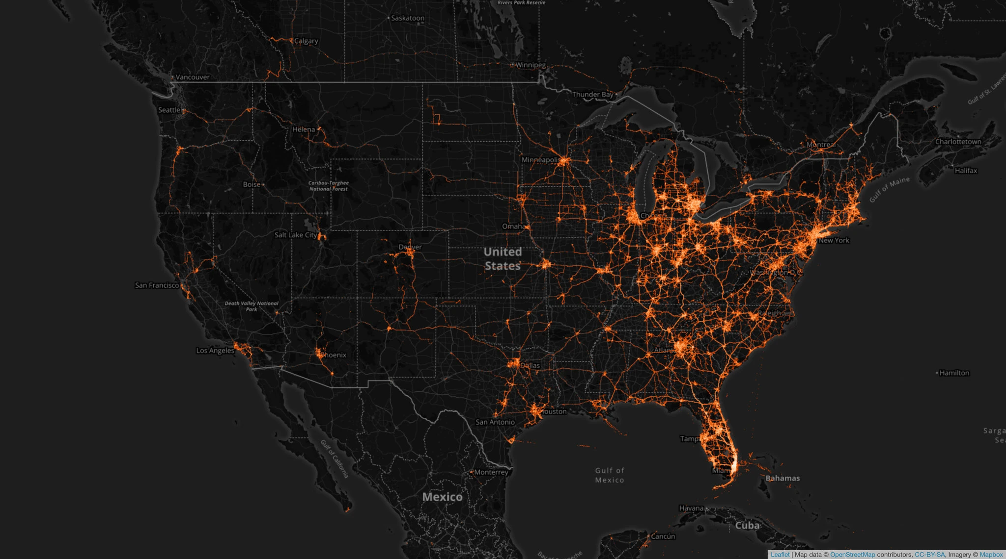

Slide 7
Spring Break vs. Spread of Covid19
Tectonix GEO and X-Mode Social by analyzing secondary locations of anonymized mobile devices that were active at a single Fort Lauderdale beach during spring break.
This image shows that spring break parties in Miami could be considered as “superspreading” Covid19, where many people gather, and then go to different areas of the country.

Slide 8
“Readymade” Data
Social scientists often conduct experiments/survey with very well defined questions
Digital data is available on the internet but not structured, and might not necessarily answer the questions that they are interested in.

Slide 9
Weaknesses of Digital Trace Data
Unstructured, Dirty
Huge amount
Incomplete
Inaccessible
Non-Representative
Drifting
Algorithmic Confounding
Sensitive

Slide 10
Alternatives to Digital Trace Data?
Survey response rates continue to drop (Census 2020)!
Many important questions require longitudinal data
Advantages of digital trace data: big, always on, non-reactive

Slide 11
Strengths of digital trace data?
Readily available once you know how to get them
Providing information about new social phenomena (fake news, deep fakes)

Slide 12
Apps can adress limitations of Digital Trace Data
Researchers are now building apps that are embeded on different platforms to collect survey data
This helps solve many problems with digital trace data
Example: Facebook is working with research institutions to collect information about how misinformation about Covid19 spreads on Facebook.

Slide 13
Bots to study social media behaviors
Bots are also used to study social media behaviors
Christopher Bail uses bots to study political polarization on Twitter
What are some ethical issues in using bots to conduct research?
Your ideas??

Slide 14
APIs
APIs have become one of the most important ways to access and transfer data online - and increasingly APIs can even analyze your data as well.
Compared to screen-scraping data, which is often illegal, logistically difficult, APIs are useful tool to make custom request for data in manner that is well structured and considerably easier to work with.
https://www.programmableweb.com/apis/directory shows that there are currently over 20,000 APIs

Slide 15
What is an API?
APIs are tools for building apps or other forms of software that help people access certain parts of large databases.
APIs help developers to integrate different products on platforms such as Youtube, Wordpress, Spotify, Google Search, etc.

Slide 16
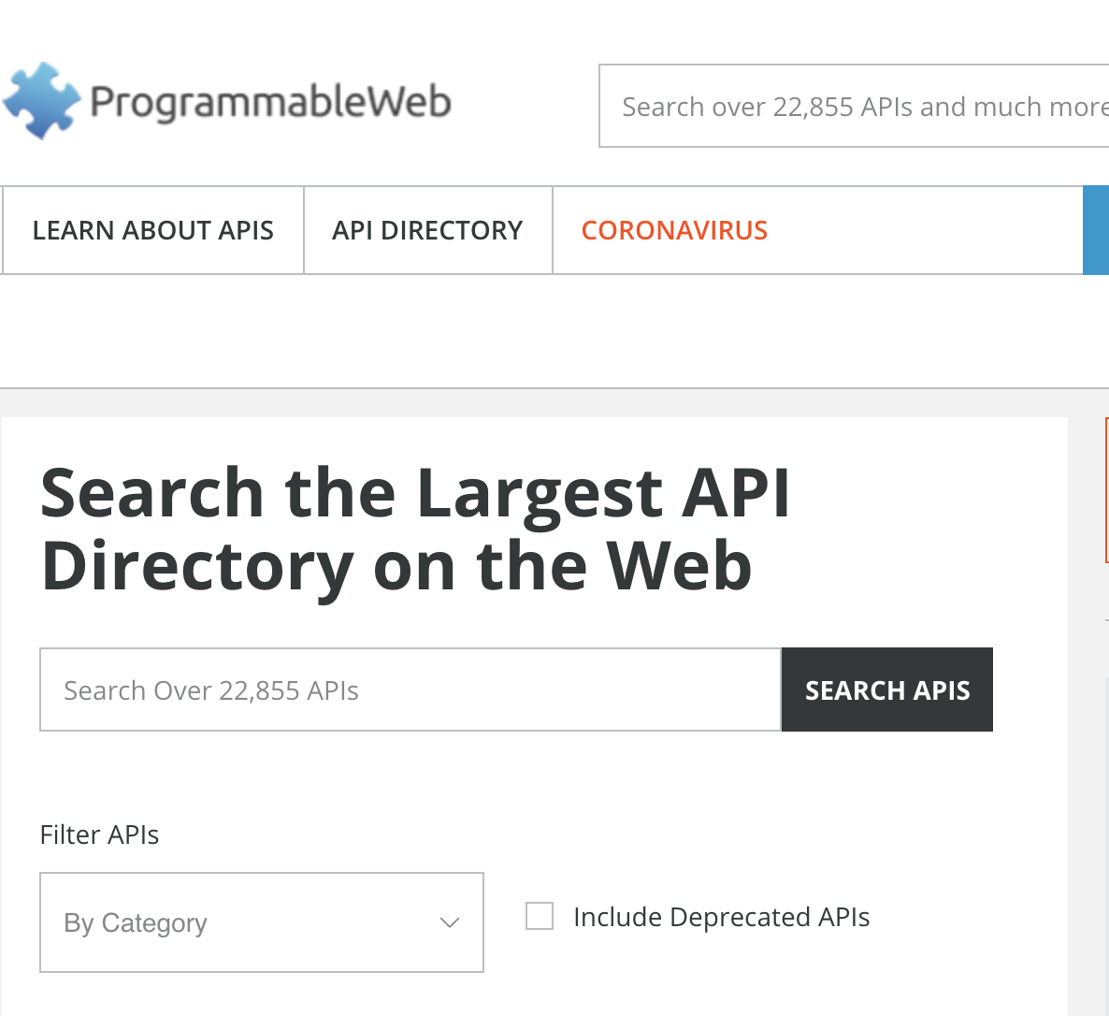

Slide 17
How does an API work?
Booking a flight
On Kayak.com, you can choose the dates, departure city, a destination city, whether the flight is return, meals, etc.
To book a flight, you need to interact with the airline’s website to access the airline’s database to see if there are any seats available according to your criteria

Slide 18
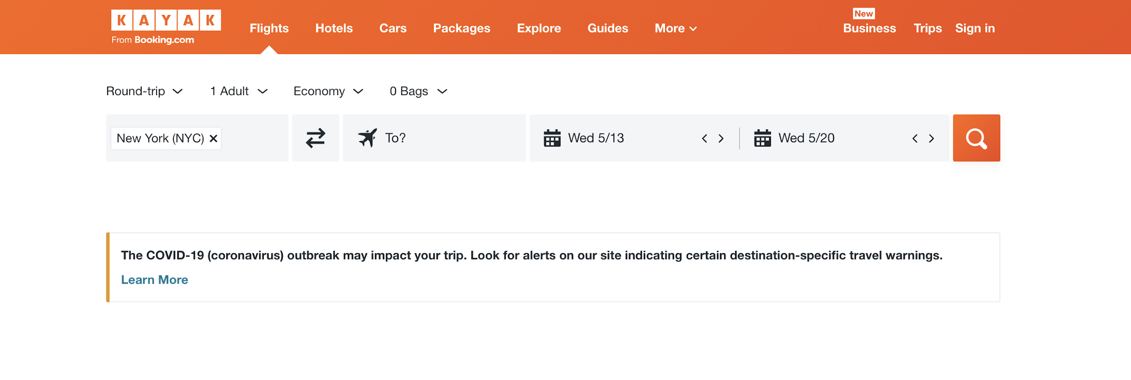
Booking a flight

Slide 19
How does an API work?
Kayak.com interacts with the airline’s API, and accesses the airline’s data
Basically, the API delivers data from the application you’re using to the airline’s systems over the Internet.
It can also take your information, and add it to the database.

Slide 20
API Credentials
We are often not aware that we’re interacting with some APIs on a daily basis.
Some APIs do not require any credentials. Others do
Example: Youtube API, Twitter API, and Google Map API

Slide 21
API Credentials
Twitter for example does not want a software developer to collect data about their users.
Twitter asks you to obtain credentials or codes/passwords that identify you and determine which types of data you’re allowed to access.

Slide 22
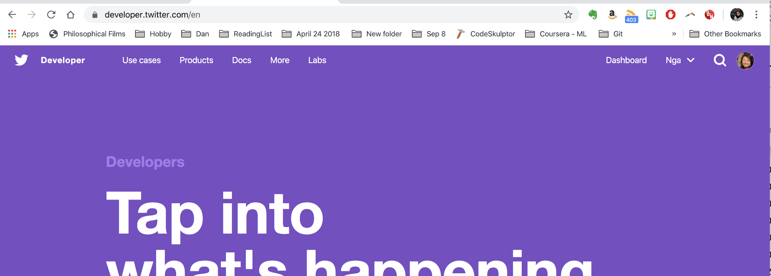
Twitter’s API

Slide 23
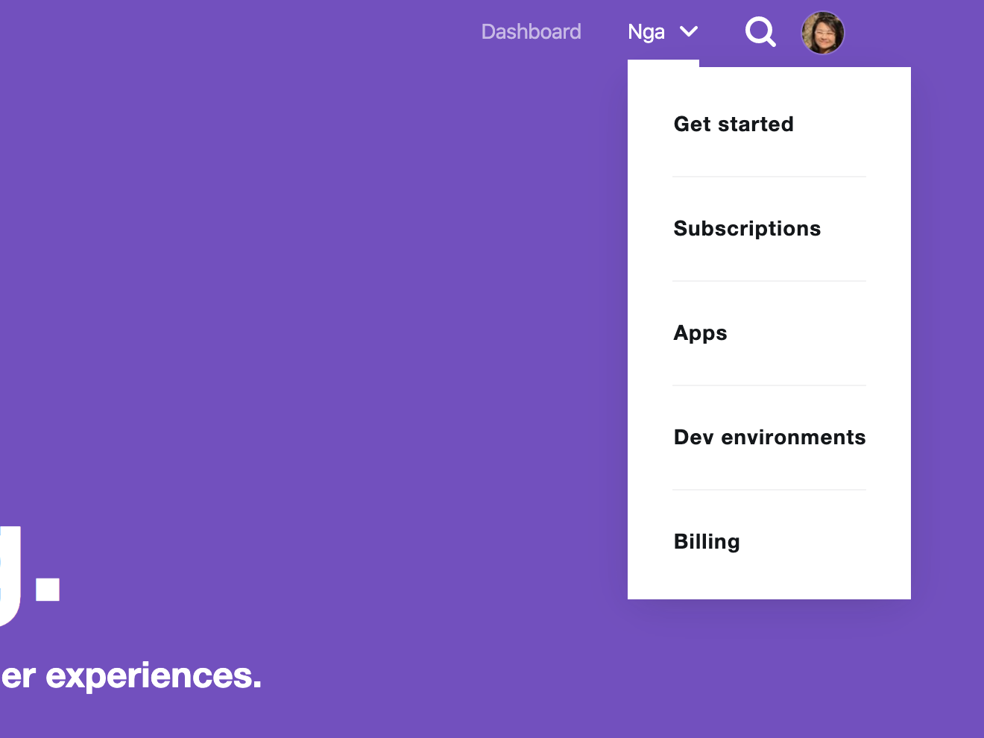

Slide 24
Create an App

Slide 25
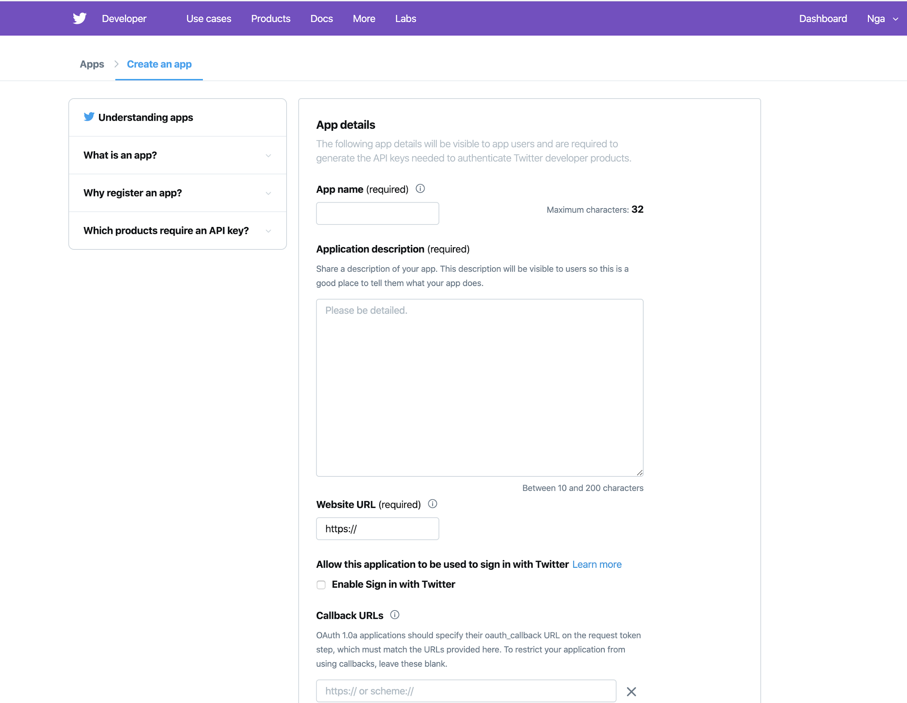

Slide 26
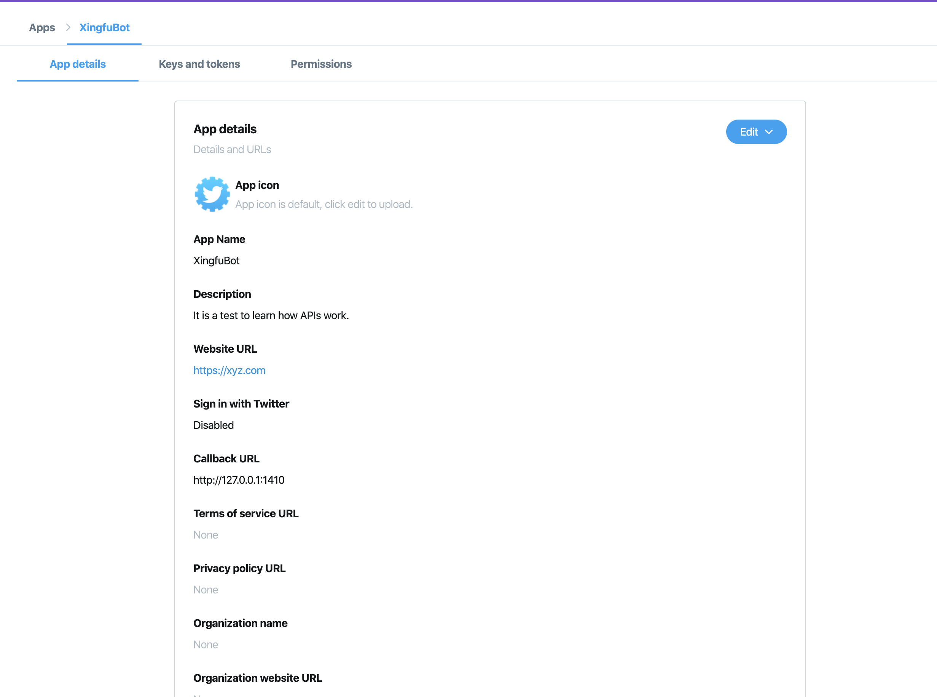

Slide 27
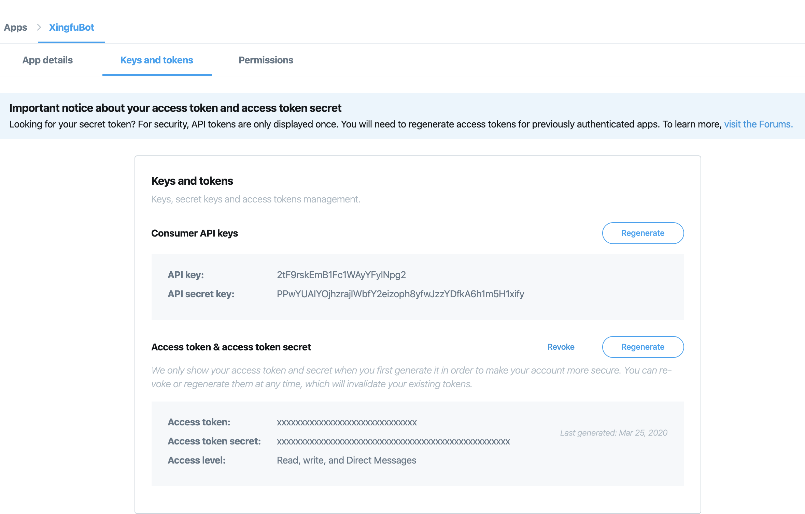

Slide 28
Twitter API
app_name<-"YOURAPPNAMEHERE"
consumer_key<-"YOURKEYHERE"
consumer_secret<-"YOURSECRETHERE"
access_token<-"YOURACCESSTOKENHERE"
access_token_secret<-"YOURACCESSTOKENSECRETHERE"

Slide 29
Extract Tweets
install_github("mkearney/rtweet")
install.packages("httpuv")
library(rtweet)
library(devtools)

Slide 30
Extract Tweets
ChineseVirus200326<-search_tweets("#ChineseVirus", n=10000000, include_rts = FALSE,
retryonratelimit = TRUE)
save(ChineseVirus200326, file = "ChineseVirus200326.RData")

Slide 31
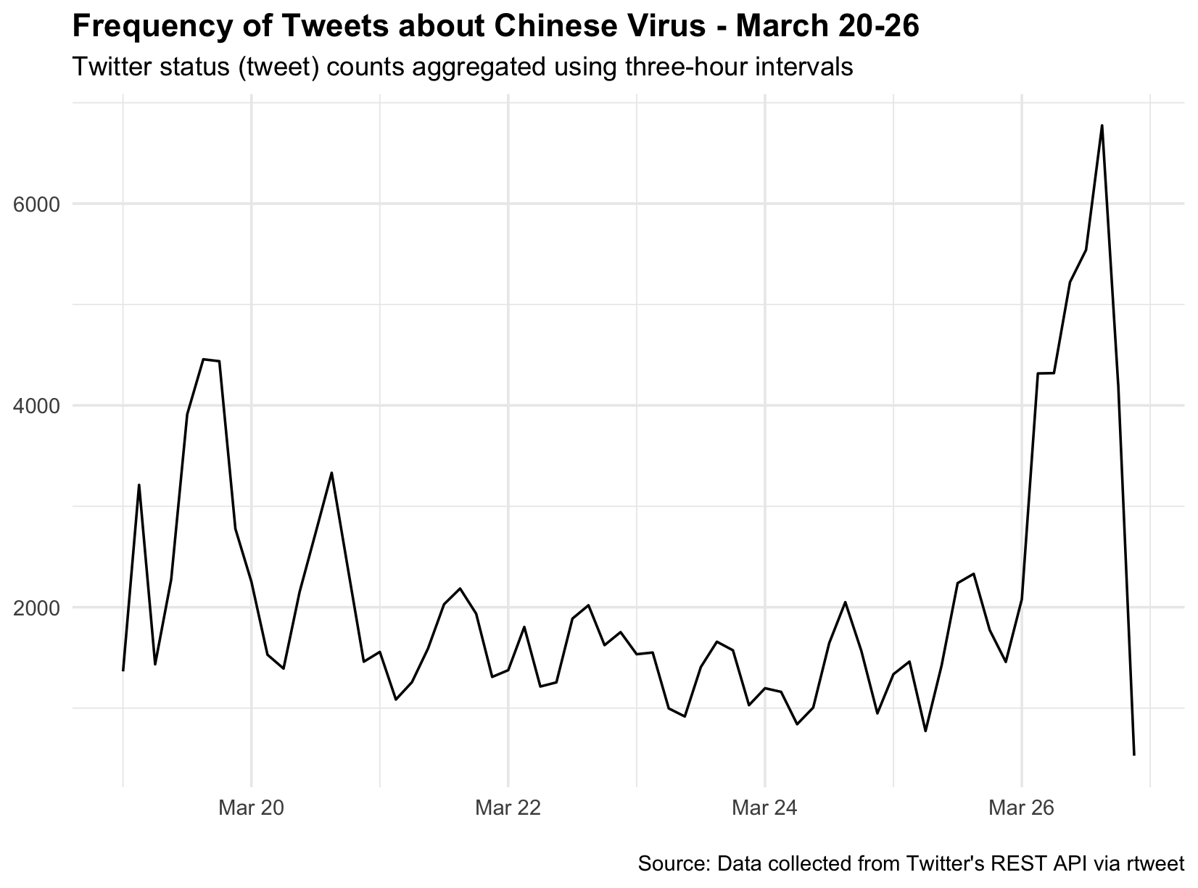
Tweet Frequency

Slide 32
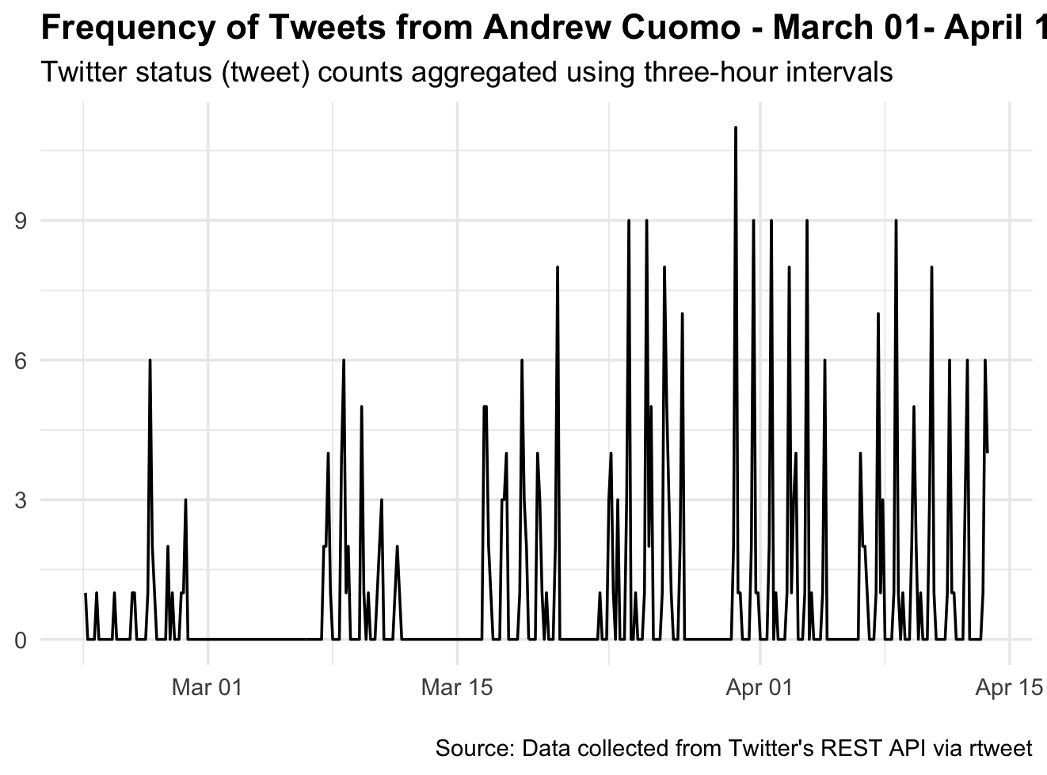
Tweets from a particular User

Slide 33
Challenges of working with APIs
obtaining credentials
avoiding rate limit
understanding the unique jargon employed by those who create each API can mean a lot of hours sifting through the documentation of an API

Slide 34
A list of APIs of interest
There are numerous databases that describe popular APIs on the web, including the aforementioned Programmable Web, but also a variety of crowd-source and user generated lists as well:
https://www.programmableweb.com/
https://github.com/toddmotto/public-apis
https://apilist.fun/
The R OpenSci site also has a list of R packages that work with APIs:
https://ropensci.org/packages/

Slide 35
Lab
Data and R scripts are on Github, folder Week 9

Slide 36
Homework
Apply for a Twitter Developer Account
Obtain Twitter API credentials
Scrape Tweets of interest
Submit: Dropbox
Due: Two weeks from now (April 27)

Slide 37
Final Presentation Sign up
https://forms.gle/vuCdYzJmpE1sRBBu8

